Slide 1
CSS342 Data Structures, Algorithms, and Discrete Mathematics (I)

Slide 2
Class Notes
Midterm result by this weekend
Last homework by next Tuesday
New homework assigned on Friday
15 minutes quiz on recursion next Tuesday
In class lab/coding exercise (to turn in) this Thursday
Binary trees

Slide 3
Recursion
Problem A
sub-problem A₁
sub-problem A₂
sub-problem A₃
…
sub-problem A_{N}
Solution

Slide 4
Recursion
Problem A
sub-problem A₁
sub-problem A₂
sub-problem A₃
…
sub-problem A_{N}
Solution
1
1
1
1
1
2
3
4
1
3
6

Slide 5
Recursion
Problem B
sub-problem B₁
sub-problem B₂
sub-problem B₃
…
sub-problem B_{N}
Solution

Slide 6
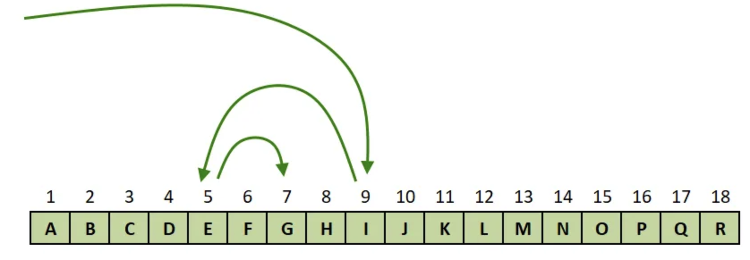
Recursion
Problem B
sub-problem B₁
sub-problem B₂
sub-problem B₃
…
sub-problem B_{N}
Solution
”decision”

Slide 7
”guess them all”
?
?
?
A gift in one of the box

Slide 8
Backtracking
Recursively try all possible solution till a solution is found
Back off if a “dead-end” is met
Output all solutions
Not all paths will lead to a answer
?
?
?

Slide 9
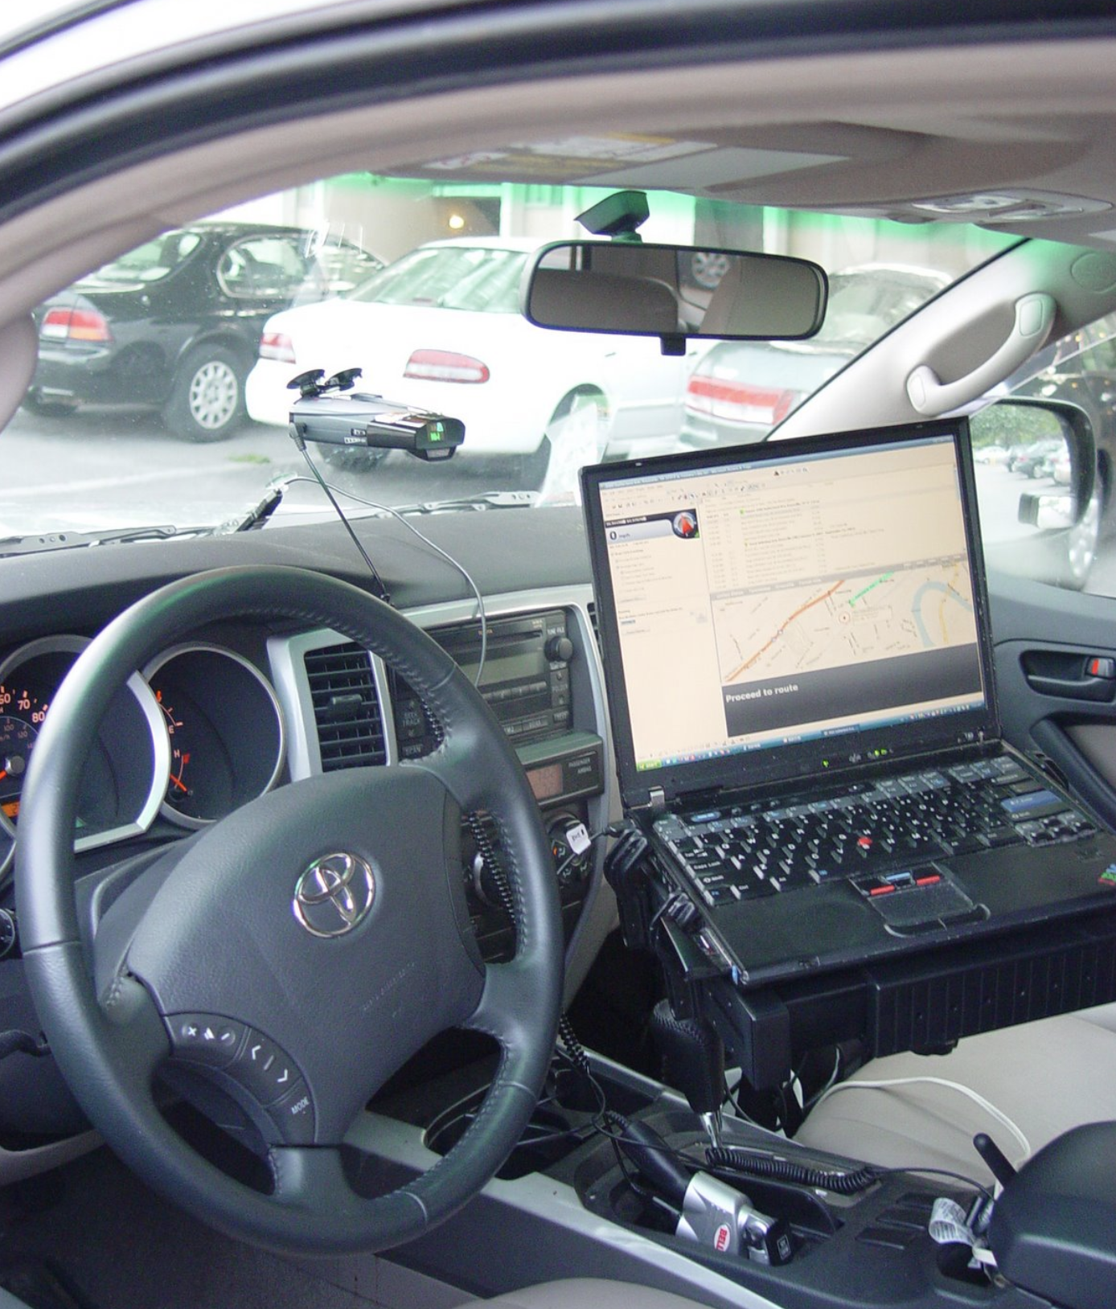
Backtracking
Kayaking trip
Fontana Lake, 07/03/2007

Slide 10
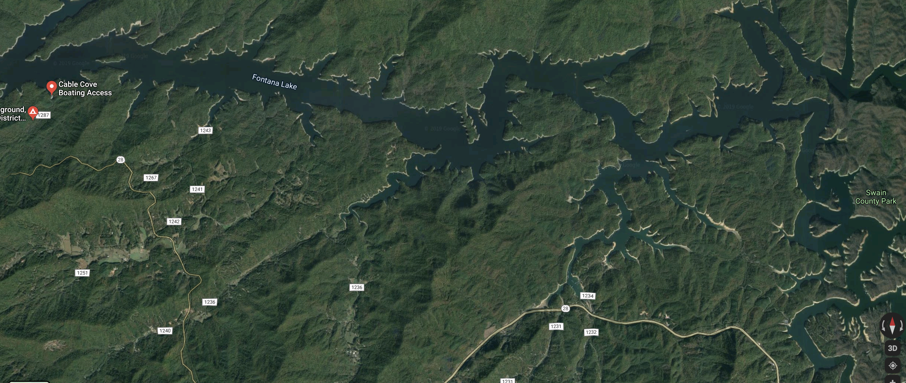
Backtracking

Slide 11
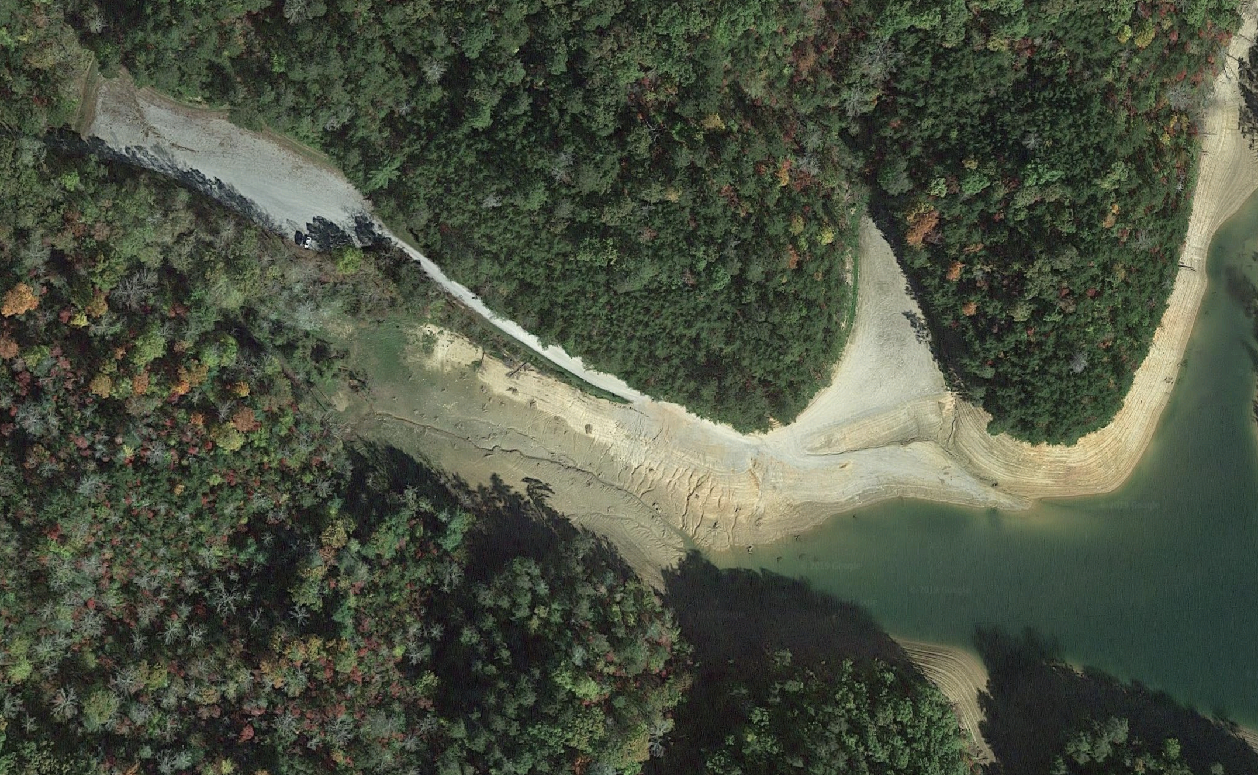
Backtracking

Slide 12

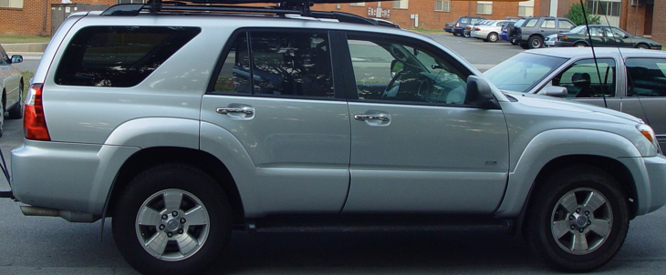
Backtracking

Slide 13
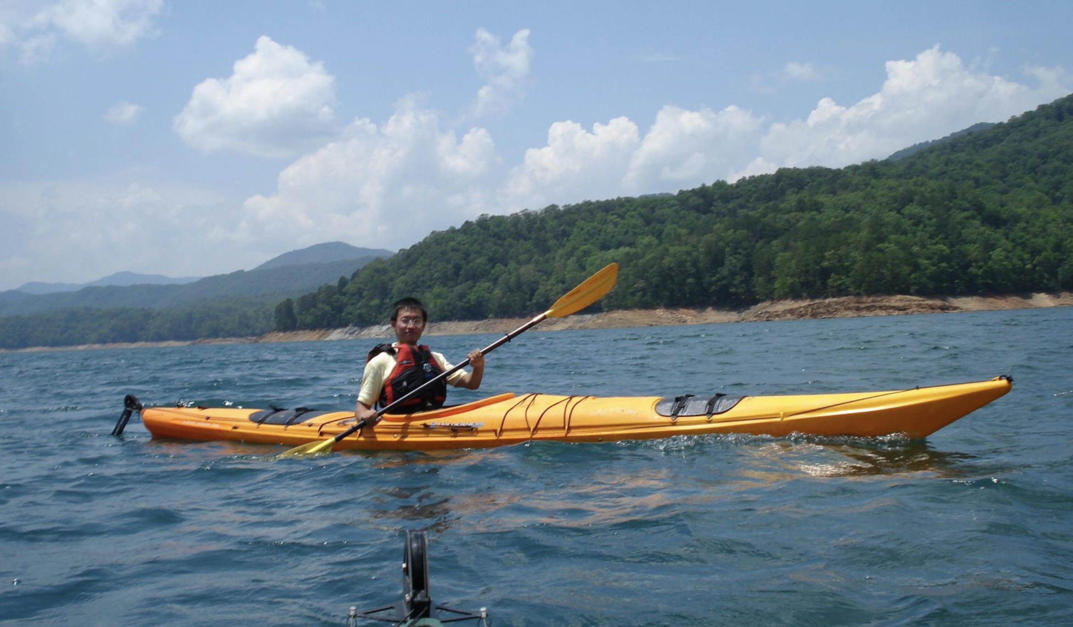
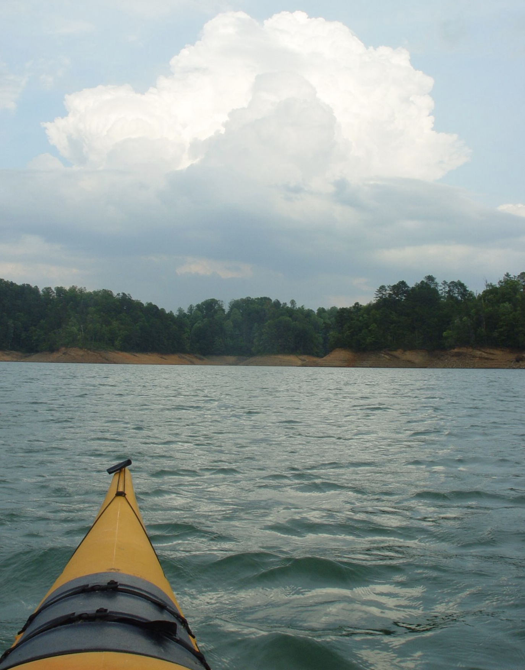
Backtracking

Slide 14
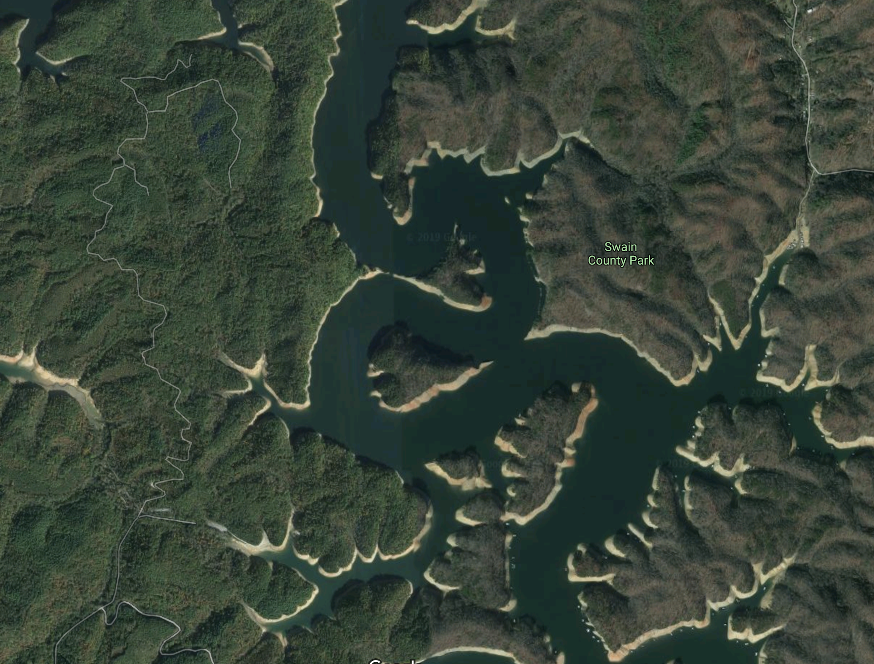
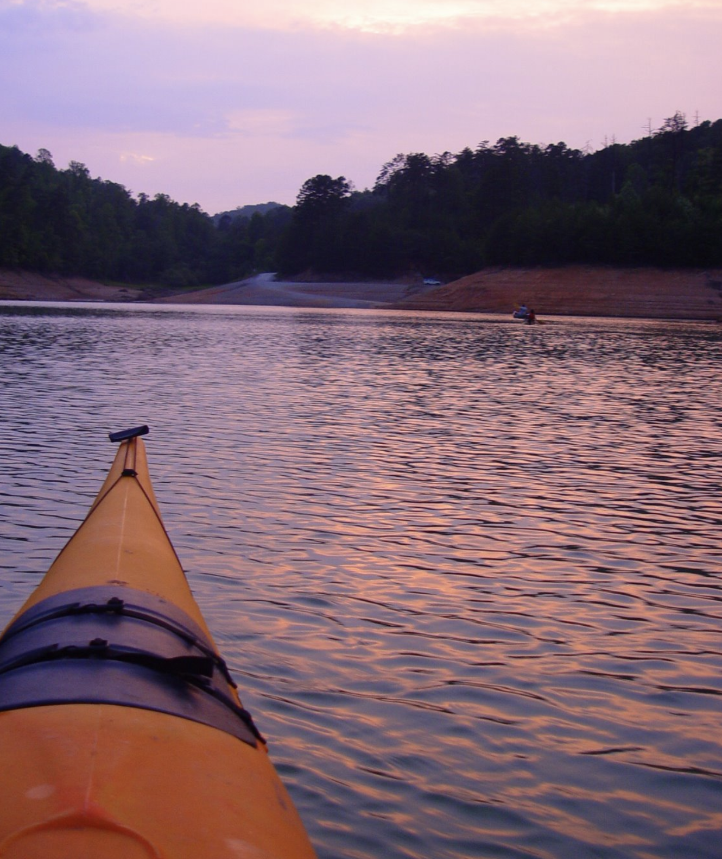


Backtracking

Slide 15
Backtracking
Move forward if there’s only one possible path
When there’s a fork, go with one of paths
If it too far, return (backtrack) to the fork, and try the other paths

Slide 16
Backtracking

Slide 17
Backtracking
TOO FAR!

Slide 18
Backtracking
NOP!

Slide 19

Backtracking

Slide 20

Backtracking trip
When in doubt, keep calm and backtrack!

Slide 21
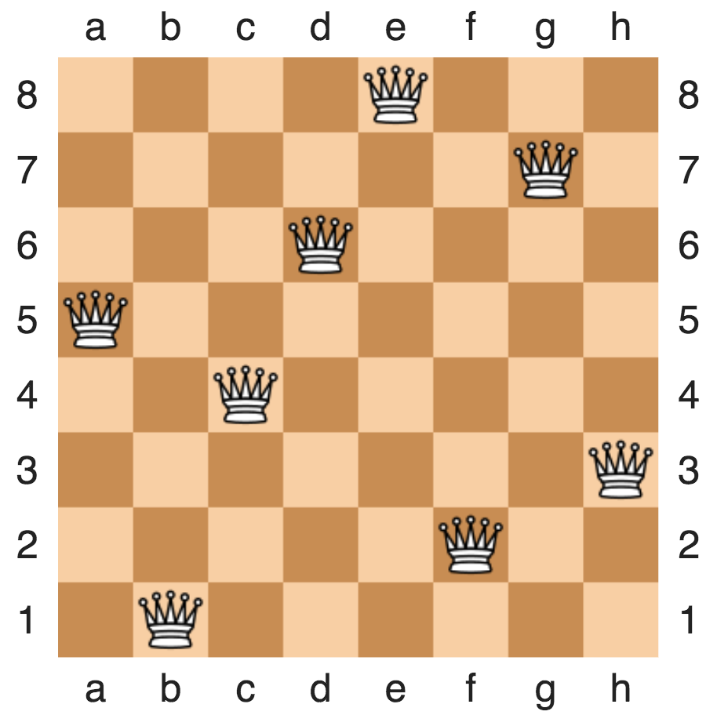
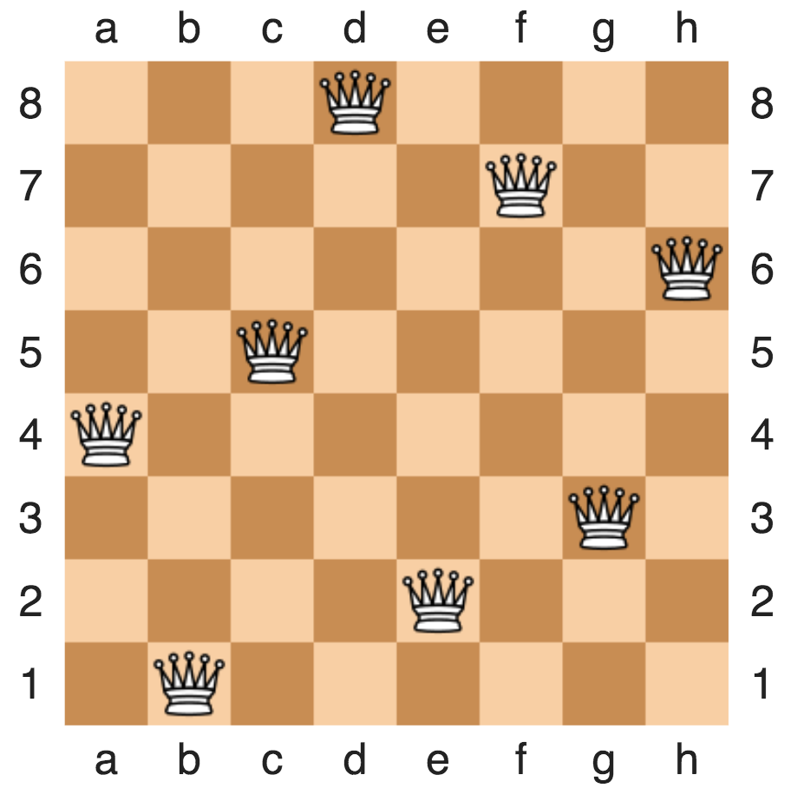
Backtracking example: 8-queue problem
Placing eight queens on an 8×8 chessboard
None of them attack one another
no two are in the same row, column, or diagonal
https://en.wikipedia.org/wiki/Eight_queens_puzzle

Slide 22
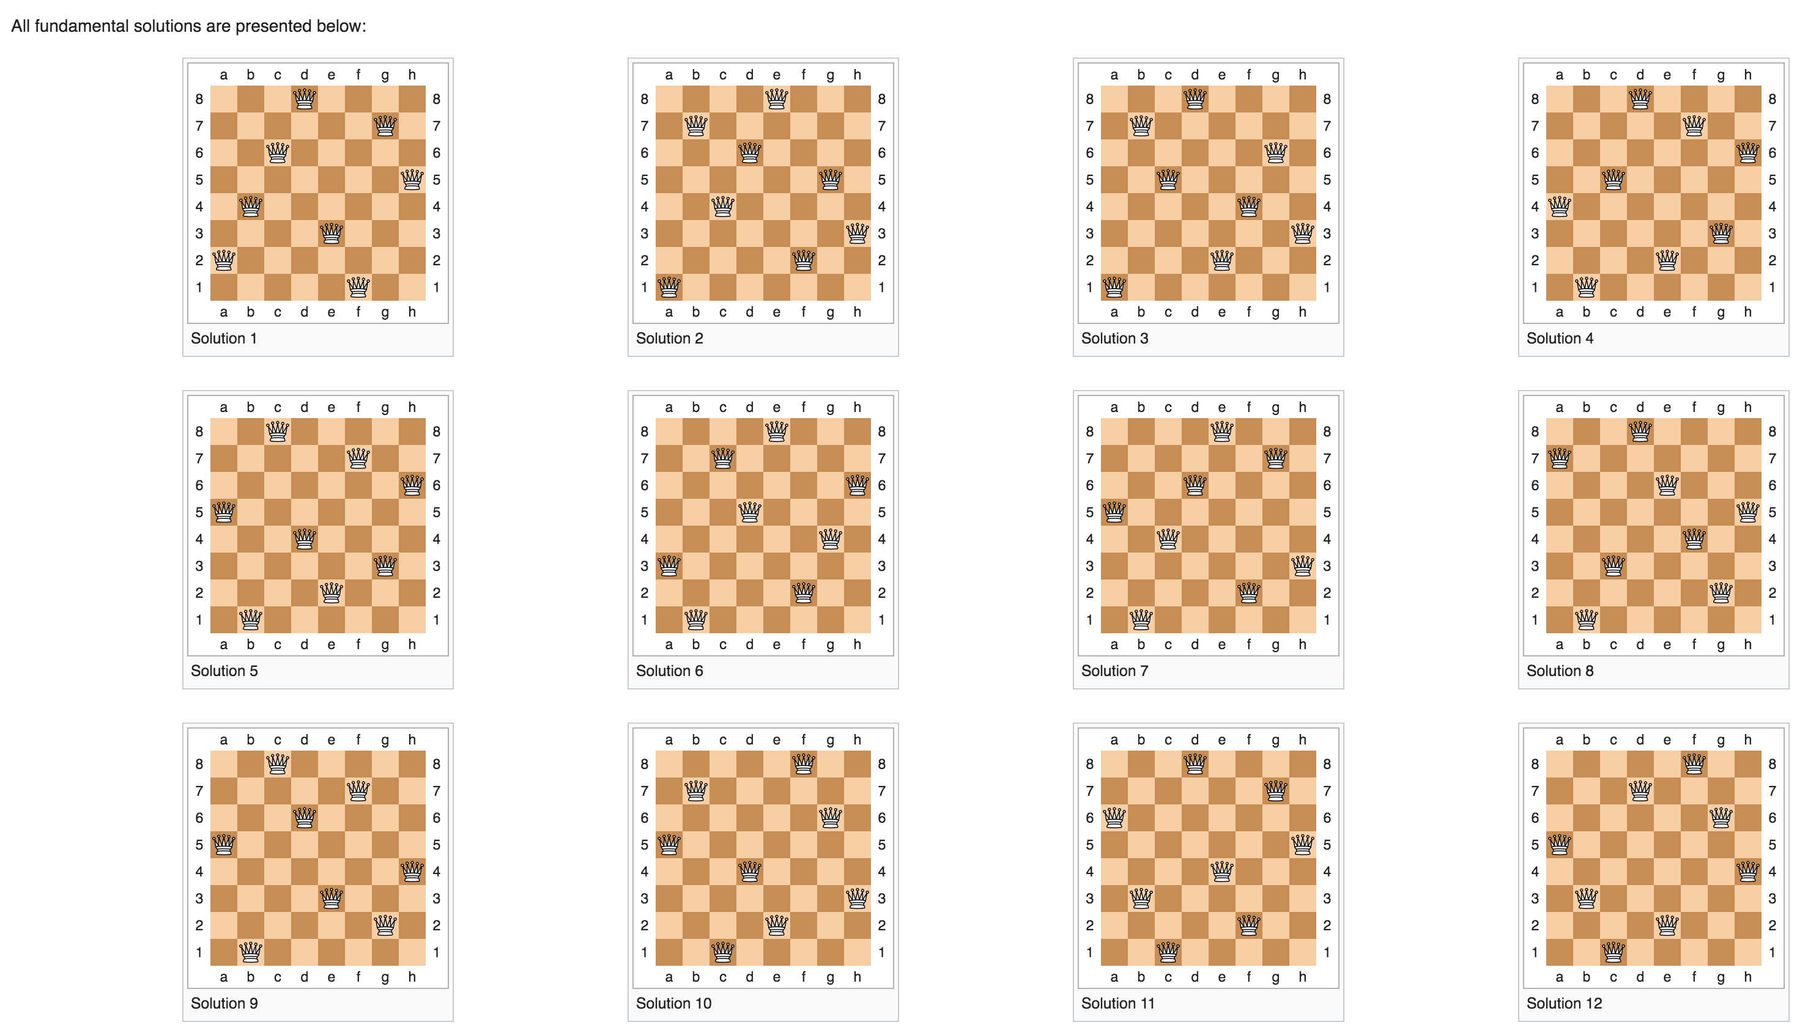
Backtracking example: 8-queue problem
Placing eight queens on an 8×8 chessboard
None of them attack one another
no two are in the same row, column, or diagonal
https://en.wikipedia.org/wiki/Eight_queens_puzzle

Slide 23
Backtracking example: N-queue problem
Placing eight queens on an N×N chessboard
None of them attack one another
no two are in the same row, column, or diagonal

Slide 24
Annimation at http://www.brainmetrix.com/8-queens/

Slide 25
Backtracking example: sudoku solver
9 x 9 grid
Each row and column contain all numbers from 1 to 9
There are 9 3x3 panels in the grid, starting with the upper left-hand corner. No 3x3 panel may contain the same number twice.
https://en.wikipedia.org/wiki/Sudoku

Slide 26
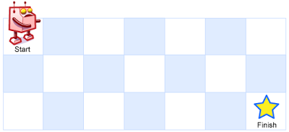
Recursion In Class Exercise
A robot is located at the top-left corner of a m x n grid (marked 'Start' in the diagram below).
The robot can only move either down or right at any point in time. The robot is trying to reach the bottom-right corner of the grid (marked 'Finish' in the diagram below).
How many possible unique paths are there?
https://leetcode.com/problems/unique-paths/

Slide 27
Recursion In Class Exercise
A robot is located at the top-left corner of a m x n grid (marked 'Start' in the diagram below).
The robot can only move either down or right at any point in time. The robot is trying to reach the bottom-right corner of the grid (marked 'Finish' in the diagram below).
How many possible unique paths are there?
1
1
1
1
2
1

Slide 28
Recursion
1
1
1
1
1
1
2
3
4
5
1
3
6
10
15

Slide 29
Backtracking Example
A robot is located at the top-left corner of a m x n grid (marked 'Start' in the diagram below).
The robot can only move either down or right at any point in time. The robot is trying to reach the bottom-right corner of the grid (marked 'Finish' in the diagram below).
Print out the possible paths

Slide 30
Backtracking: all possible paths
[0, 1, 2]
[0, 1, 2, 5]
0
1
2
0
1
2
[0, 1]
3
4
5
3
4
5
0
1
2
[0, 1, 4]
[0, 1, 4, 5]
[0]
3
4
5
0
1
2
0
1
2
0
0
1
1
2
2
3
4
5
3
4
5
4
4
5
3
5
3
[0, 3]
[0, 3, 4]
[0, 3, 4, 5]
0
1
2
0
1
2
0
1
2
3
4
5
3
4
5
3
4
5

Slide 31
Backtracking: all possible paths
[0, 1, 2] (M=1, N=2)
[0, 1, 2, 5] (M=1, N=1)
0
1
2
0
1
2
[0, 1] (M=2, N=2)
3
4
5
3
4
5
0
1
2
[0, 1, 4] (M=2, N=1)
[0, 1, 4, 5] (M=1, N=1)
[0] (M=3,N=2)
3
4
5
0
1
2
0
1
2
0
0
1
1
2
2
3
4
5
3
4
5
4
4
5
3
5
3
[0, 3] (M=3, N=1)
[0, 3, 4] (M=2, N=1)
[0, 3, 4, 5] (M=1, N=1)
0
1
2
0
1
2
0
1
2
3
4
5
3
4
5
3
4
5

Slide 32
Backtracking Example
How to represent 2D array?
“Column major” : stores column by column
0
1
2
N=2 rows
3
4
5
M=3 columns
0
3
1
4
2
5
Data at location column i, row j : array[j*N+i]

Slide 33
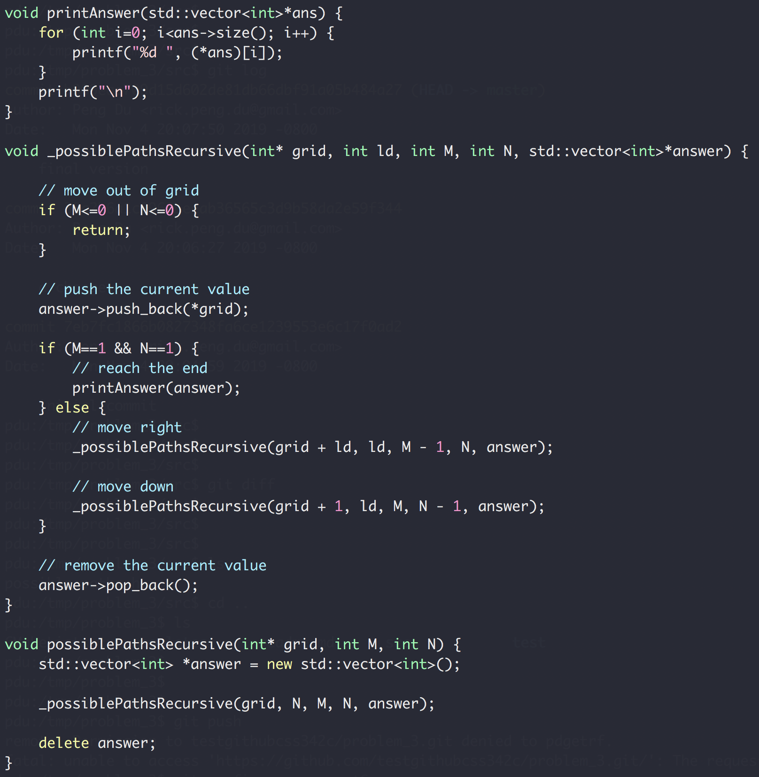

Slide 34
Backtracking Example
Write a function to generate all possible N pairs of balanced parentheses.
N=1 → { }
N=2 → { } { } { { } }
{ } { } { }
{ } { { } }
{ { } } { }
{ { } { } }
{ { { } } }
N=3 →

Slide 35
Backtracking Example
Write a function to generate all possible N pairs of balanced parentheses.
Balanced: number of open parenthesis >= number of close parenthesis
number of any parenthesis <= N
N=2
{ { _{(2,0)}
{ { } _{(2,1)}
{ { } } _{(2,2)}
{ _{(1,0)}
{ } _{(1,1)}
{ } { _{(2,1)}
{ } { } _{(2,2)}

Slide 36
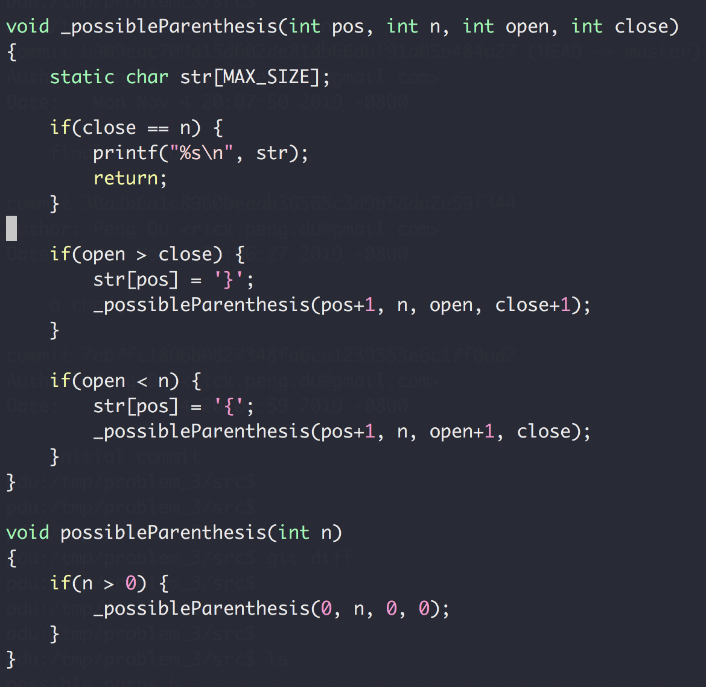
Backtracking Example
Write a function to generate all possible N pairs of balanced parentheses.

Slide 37
Recursion Summary
Largest number in an array
Subproblem: size – 1 of the array, not efficient
Binary search
Subproblem: half of the array, efficient
Possible stairs / number of unique paths
Subproblem: not efficient
Chasing solution
N-queue
all unique paths
Sudoku solver
parentheses
Trial and error

Slide 38
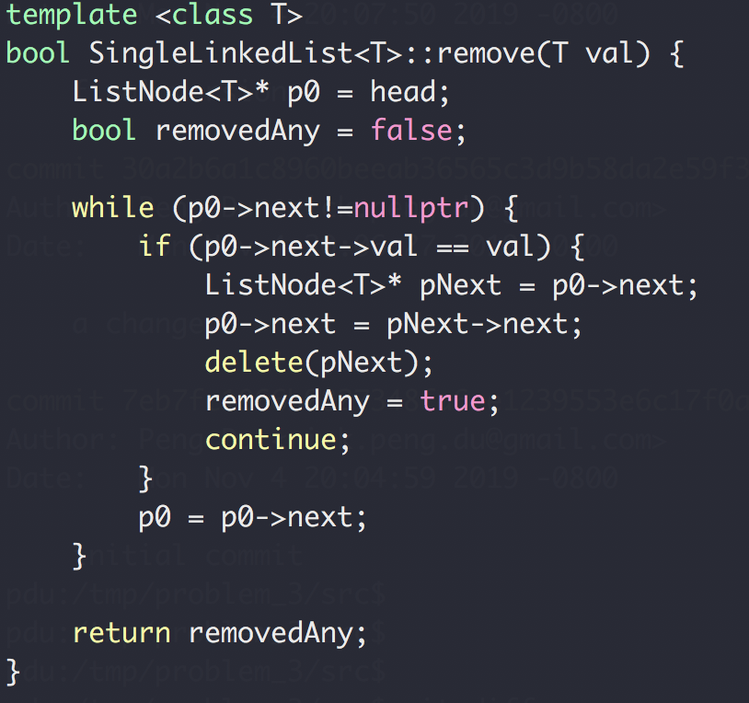
Homework Review
Remove()
head
Next
Next
Next
Next
end

Slide 39
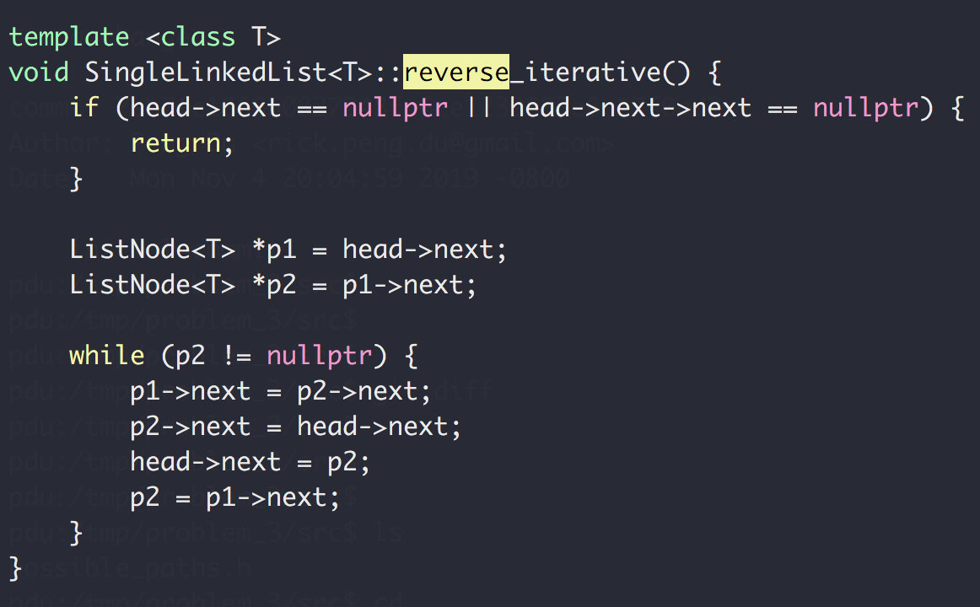
Homework Review
reverse_iterative()
h → 1 → 2 → 3 → 4 → N
h → 2 → 1 → 3 → 4 → N
h → 3 → 2 → 1 → 4 → N
h → 4 → 3 → 2 → 1 → N

Slide 40
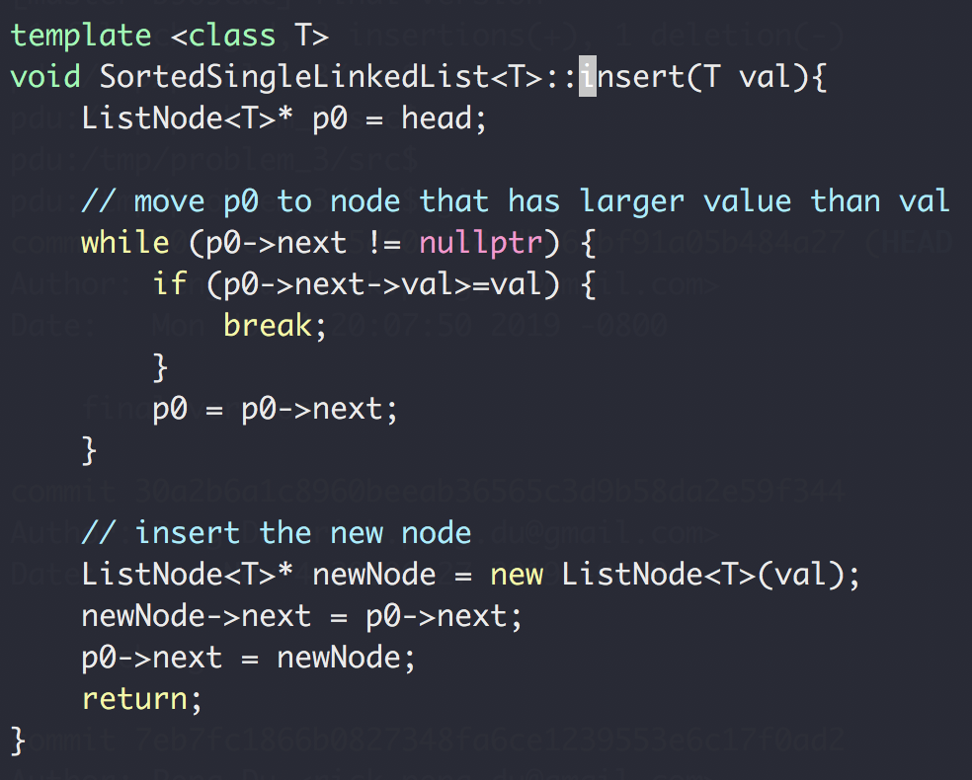
Homework Review
Insert into sorted single linked list
h → 3 → 6 → 9 → N
Insert 5
h → 3 → 5 → 6 → 9 → N

Slide 41
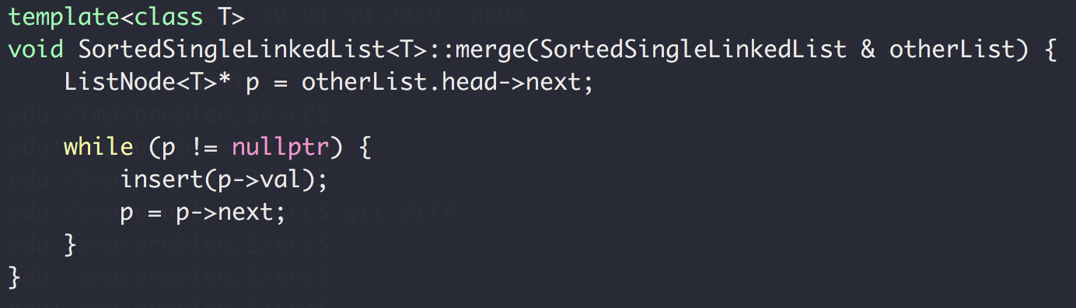
Homework Review
Merge sorted single linked list
h → 3 → 6 → 9 → N
otherList: h → 2 → 5 → 10 → N
h → 2 → 3 → 5 → 6 → 9 → 10 → N

Slide 42
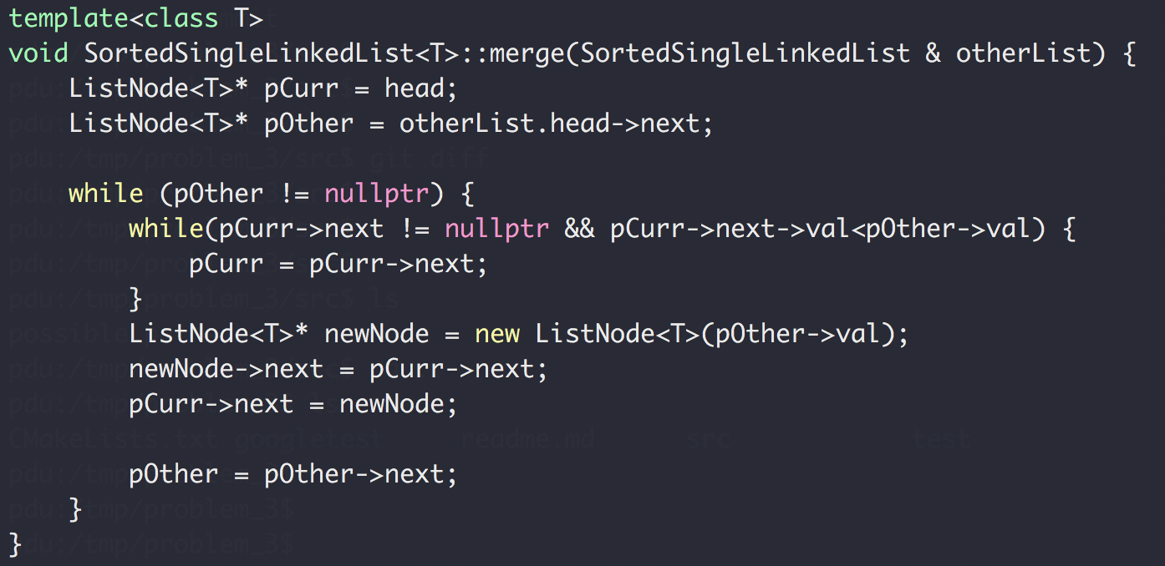
Homework Review
Merge sorted single linked list
h → 3 → 6 → 9 → N
otherList: h → 2 → 5 → 10 → N

